Slide 1
Inventory Management System: Semester 1 Demo
By:
David Erickson
August Davis
Christian Hansen

Slide 2
Our goals
Create an inventory system application that:
Can scan the barcodes located on all department equipment
Makes accessing and modifying inventory data easy for the user
Protects the inventory data from unauthorized actions
Runs on Android
Document the project in a way that will allow others to easily modify the project at a later date

Slide 3
The Road so far
We have broken the project in to three parts:
The backend database
How to scan the barcodes in to the application
The main UI

Slide 4
Progress on database
We know where we will host it: we have permission to host it on the departments servers.
We have all of our data fields mapped out

Slide 5
Progress on barcode scanning
The original plan was to use google vision to scan our barcodes, this was a dead end
Plan B is the Zebra crossing app or a library version of it via XZing.Net.Moblie
Do to an unfamiliarity with the library, C# and Visual Studio we are currently in the experimentation faze of getting this component working and integrated in to the main application UI.

Slide 6
Main Application UI
We don’t have a better way to demo this so here's some screen shots

Slide 7
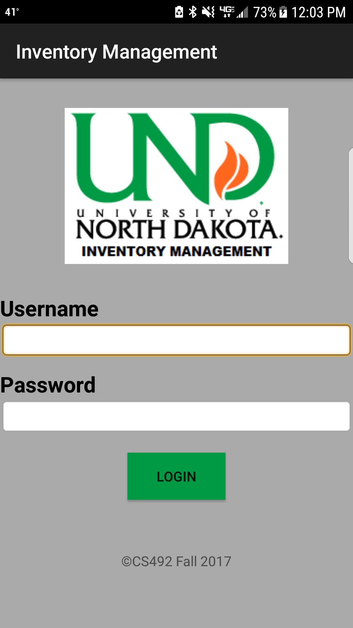
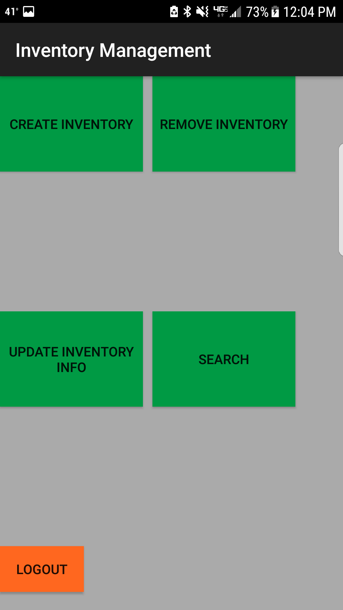
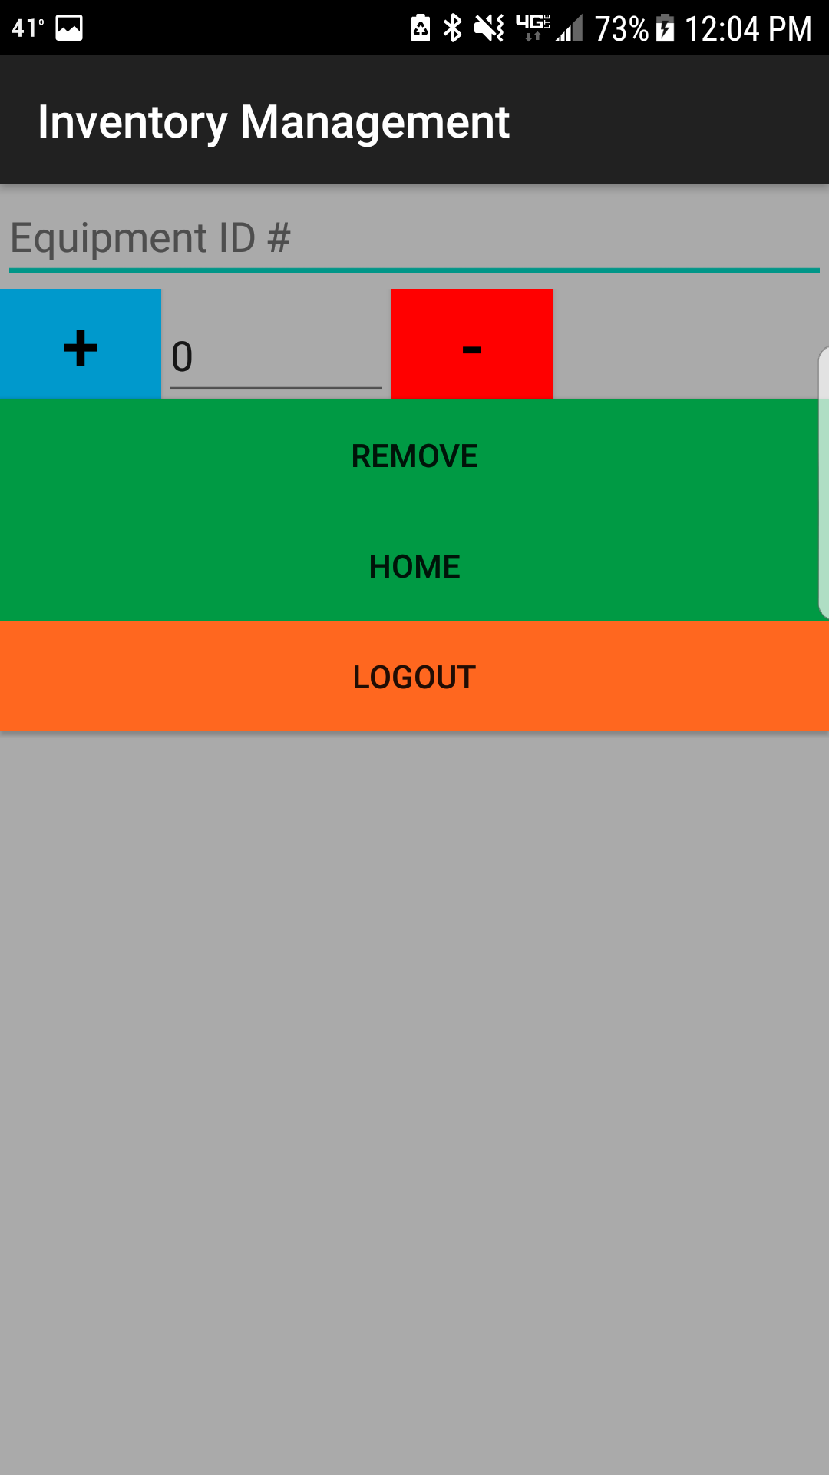

Slide 8
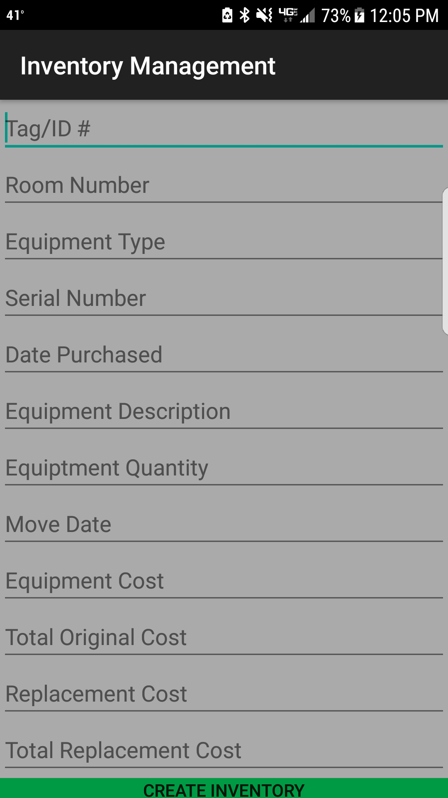
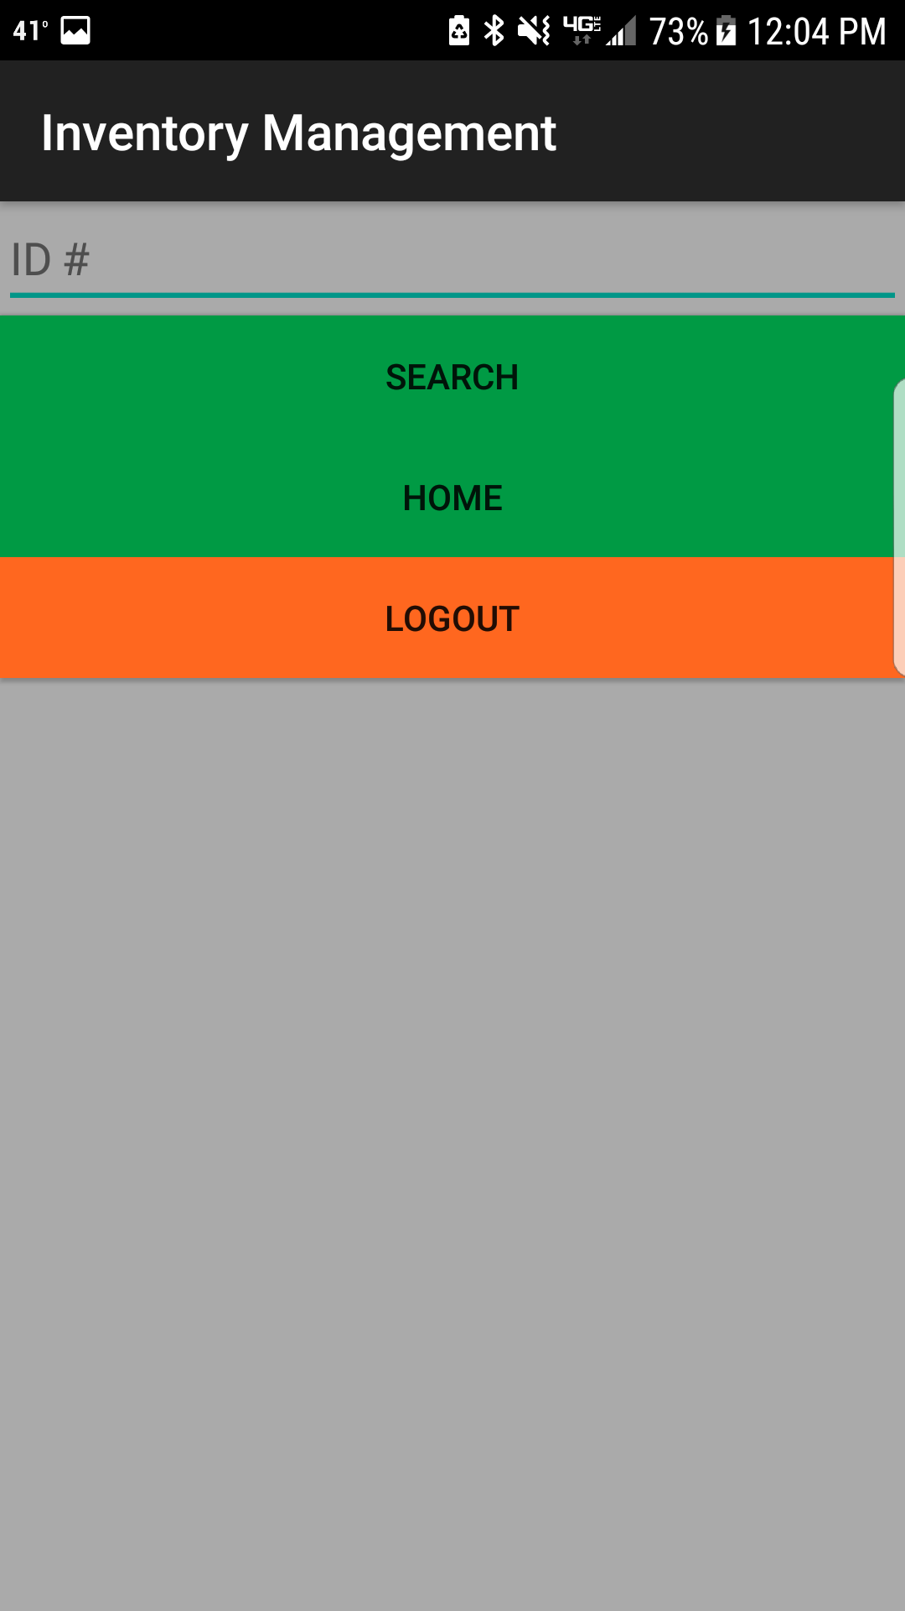
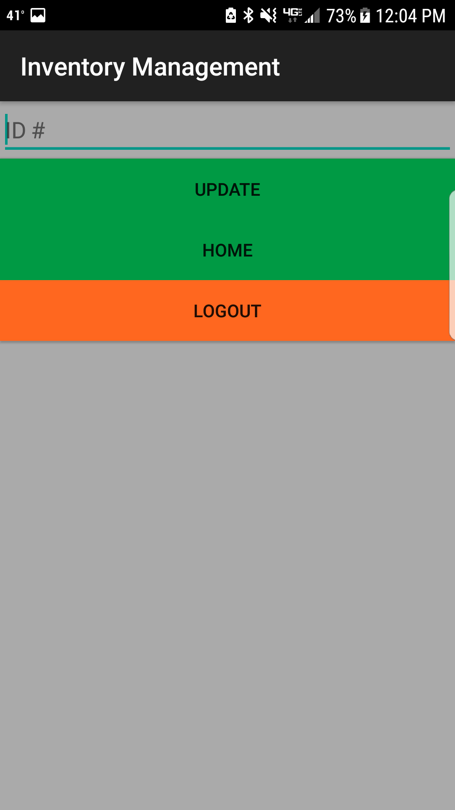

Slide 9
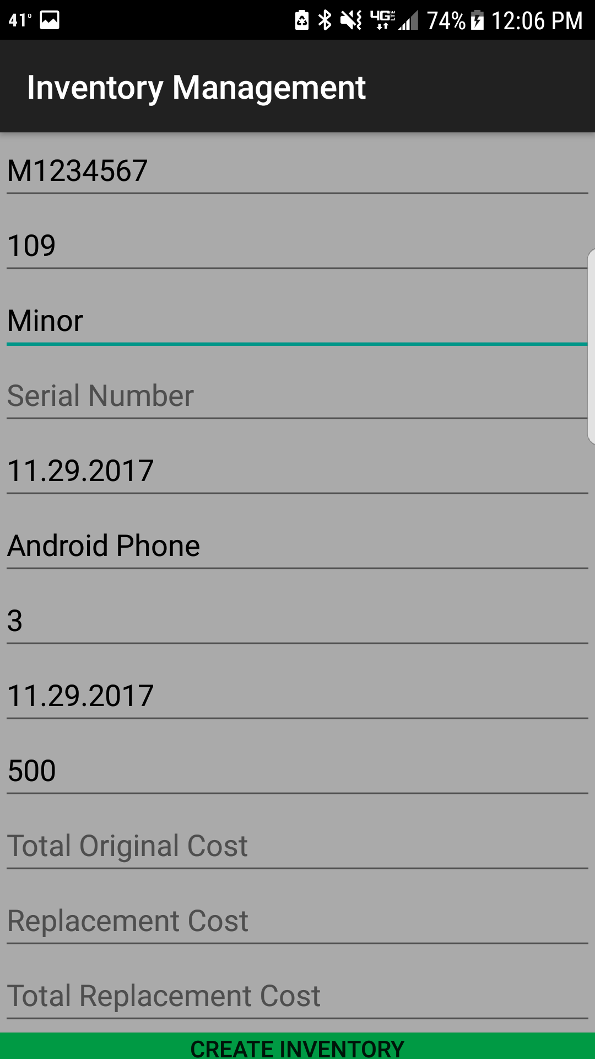

Slide 10
The immediate Road ahead: (now – end of winter break)
Develop a better understanding of Zebra Crossing
Continue to improve the UI prototype
Add more documentation to the project

Slide 11
Further down the road: (next Semester)
Create and deploy our database
Write web hooks to connect UI to our database adding the appropriate security measures
Integrate Zebra crossing into our application
Finalize our UI
Package our documentation and Application in a way that makes its use easy for future developers to work with.

